Slide 1
Financial Aid Webinar
Live presentation and Q&A on
tuition adjustment & scholarships
Wednesday, January 22nd, 2025 from 4-5pm
Director of Admissions, Marketing and Communications - Karlena Alonso Lamm
Finance Director - Laurie Thompson

Slide 2
Our Guiding Principles
The Denver Waldorf School (DWS) is committed to economic diversity. The Board of Trustees, College Leadership Council, Faculty, Administration and Parents work together to raise funds, volunteer, and make challenging budgetary decisions to keep tuition within the financial means of the largest possible group. We seek to establish financial relationships that are healthy for the school and the families within our community.

Slide 3
At DWS, we recognize that many families want the inspired learning environment that an independent Waldorf education provides, and that this type of education requires a significant financial commitment. Therefore, DWS budgets a significant portion of income to our Tuition Adjustment Program, but the budgeted funds are limited. All families who wish to provide Waldorf education for their child(ren) are encouraged to seek the means to make this education a viable option.

Slide 4
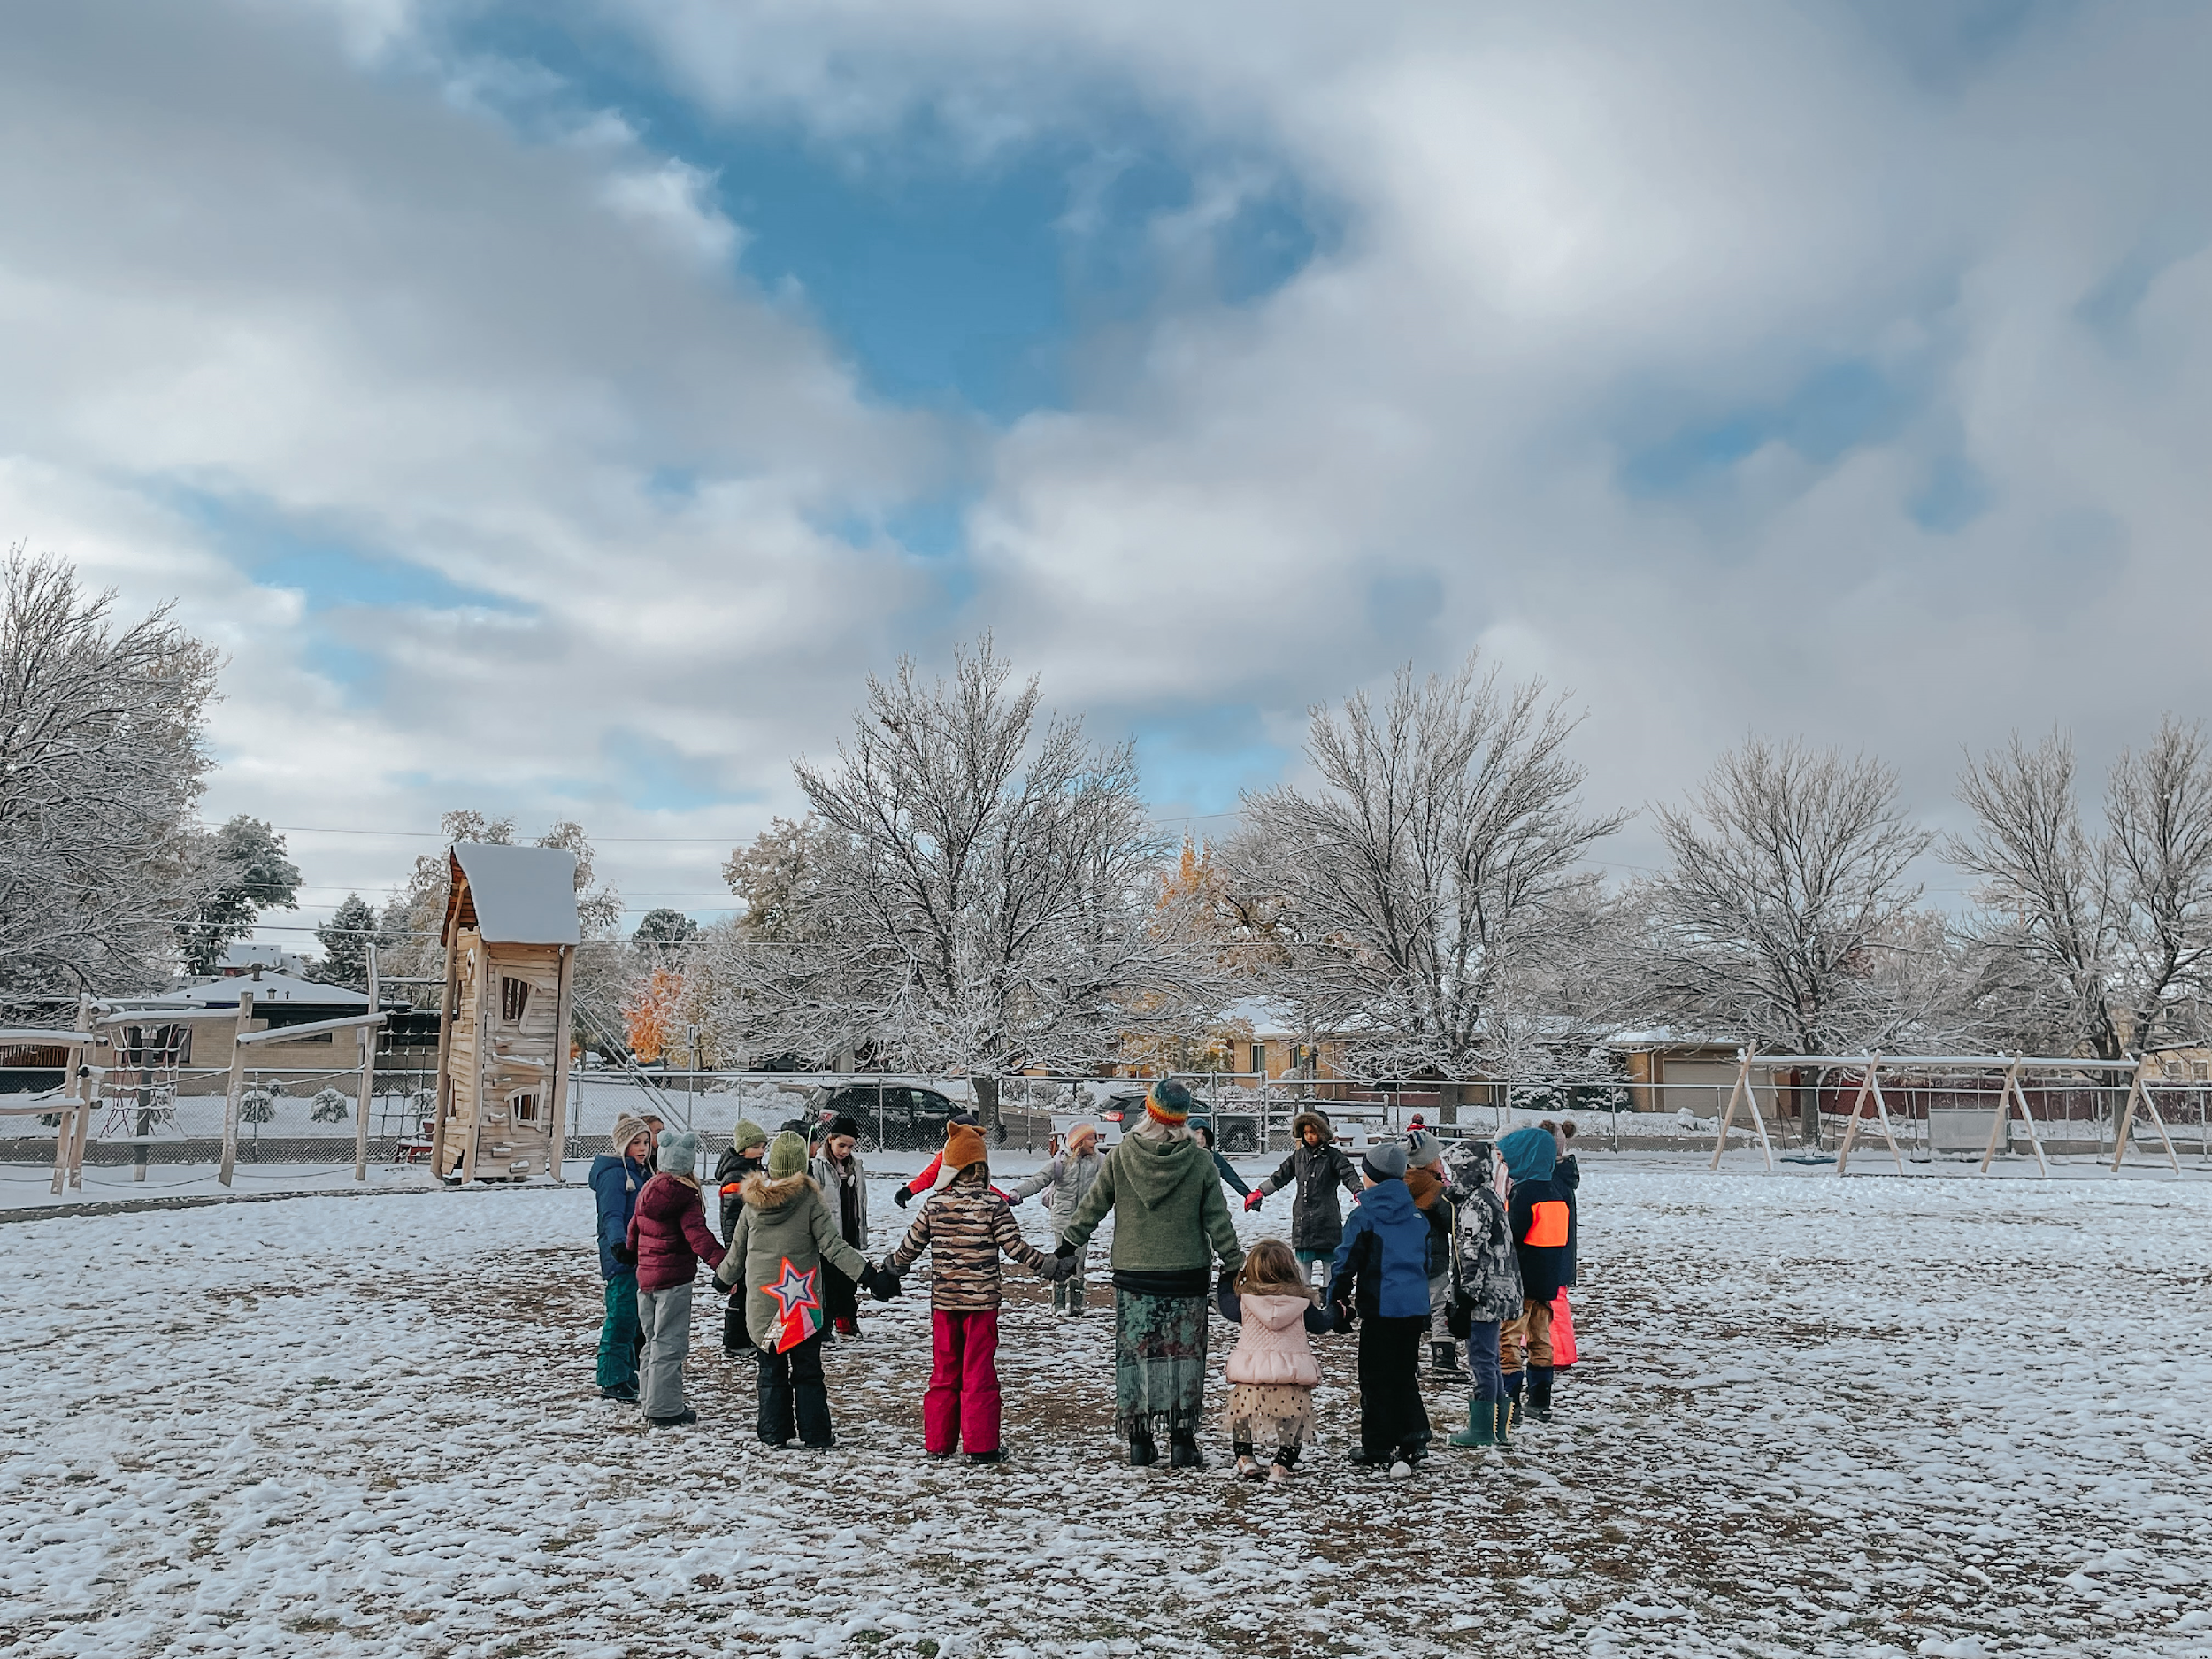
DWS expects families to exercise their best creative efforts to use their own financial resources before turning to the Tuition Adjustment Program. Tuition Adjustment is not based on willingness to pay, but on one’s ability to pay.

Slide 5
Tuition Adjustment Overview
Tuition Adjustment Applications for returning DWS students will be reviewed only if their current tuition and other school financial obligations are up-to-date.
Tuition Adjustment is available for children in 1st through 12th Grades.
Tuition Adjustment in Kindergarten is available only to students enrolled for five full days in their final year of Kindergarten, and is not available for students in Pre-Kindergarten.
Tuition Adjustment can range between 5% and 50% of tuition, based on financial need.
There are small additional scholarships that are also available. If you wish to apply for one or more scholarships, please do so at the same time that you apply for Tuition Adjustment.
All financial and personal information is kept completely confidential.
Completed Tuition Adjustment applications through SSS/TADS are due within two (2) weeks of re-enrollment or acceptance to The Denver Waldorf School.

Slide 6
SSS/TADS and Determining Your Family’s Financial Need
DWS uses SSS/TADS (School and Student Services / Tuition Aid Data Services) to provide an objective and consistent method of determining a family’s ability to contribute to educational expenses. SSS/TADS is a nationally recognized, third-party system that standardizes the financial review process and supports a healthy balance of awards.
SSS/TADS Financial Aid Assessment uses key financial information to evaluate a family’s need for financial aid. SSS/TADS verifies the financial information provided on the application, and then calculates discretionary income based on many factors, including but not limited to all sources of income, assets, expenses, indebtedness and family size, and includes a calculation for a base living allowance. The higher discretionary income a family is calculated to have, the lower the SSS/TADS recommended Tuition Adjustment award.

Slide 7
SSS/TADS and Determining Your Family’s Financial Need
SSS/TADS will make a recommendation to DWS on how much financial assistance is needed by all the families who have applied. The Tuition Adjustment Committee bases the Tuition Adjustment award on the SSS/TADS recommendation, in order to provide an objective and fair process for all families.
The Tuition Adjustment Committee will not evaluate or determine Tuition Adjustment until all processes with SSS/TADS are complete, including all required documents. Please watch for emails from SSS/TADS after you submit the application to make sure you have provided everything they need for the assessment.

Slide 8
Tuition Adjustment and Determining Your Family’s Needs
Information for Divorced or Separated Parents
DWS will consider the financial information of both parents in making a tuition adjustment assessment. DWS is not bound by the assertion that one parent has disclaimed responsibility for education expenses except in the case of a documented court determination.
Information for Step-Parents and Unmarried Partners
If either parent has remarried or has a significant other/partner living in the home, SSS/TADS and the Tuition Adjustment Committee will require the partner’s financial information to be considered. Therefore, the partner’s financial information must be included on the application in order for it to be accepted. Income, expenses, assets and liabilities for the entire family unit are considered.

Slide 9
Tuition Adjustment Process 2025-26
Sign the contact(s) in the BigSIS/Ravenna parent portal.
Go to: mytads.com and click on Financial Aid Assessment to complete and submit your financial information to SSS/TADS. This application, once complete, will allow SSS/TADS to make a tuition adjustment recommendation to the TA Committee.
Be prepared with 2023 tax returns and other financial information. The application process will take one to two hours. Applications received after 4.15.2025 will require submission of 2024 tax returns.
All Financial and Tax documents will be required to be uploaded to SSS/TADS in order to review.
SSS/TADS has a $60 application fee that will be charged upon submission of the application
SSS/TADS will email you with requests for additional information, so please monitor your email after the application is submitted. Please respond to all questions and requests as quickly as possible.
If you wish to apply for one or more scholarships, please do so at the same time that you apply for Tuition Adjustment. Scholarship applications are submitted online and are available on the DWS website under the Admissions tab.

Slide 10
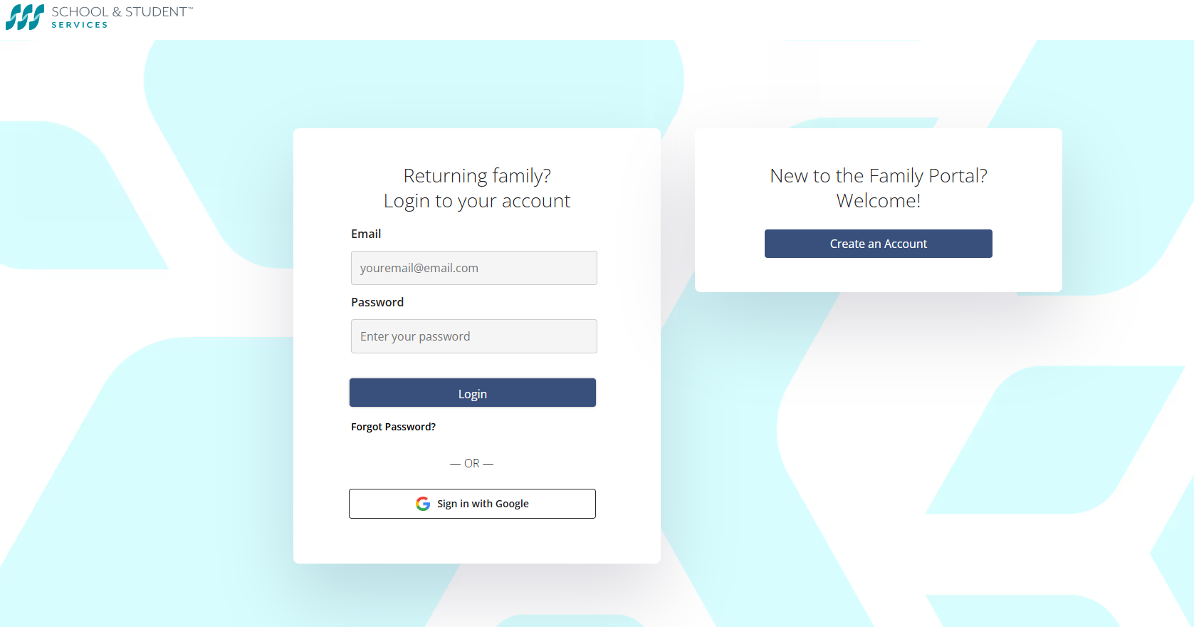
SSS/TADS Financial Aid

Slide 11
Tuition Adjustment Awards Review
Complete your SSS/TADS application within two weeks of signing your contract
Apply for scholarship(s) at the same time so that they can be considered in the award process
This will allow the TA Committee to review your full application in a timely manner
The TA Committee includes the Director of Admissions, Marketing and Communications, the Director of Enrollment Records, the Finance Director and the School Director who review the full application. Next a faculty member and a member of the Board of Trustees will review their recommendation - without names or other identifying information included.
SSS/TADS makes a recommendation for a TA award based on each family’s HAI (Household Adjusted Income), that takes into account revenue and expenses, as well as debt and assets, in order to give an equitable award.
The policy and procedure are objective and fair, with compassion and based on a sense of community
The TA Committee bases the TA award on the objective SSS/TADS recommendation, calibrated to meet our annual budget.

Slide 12
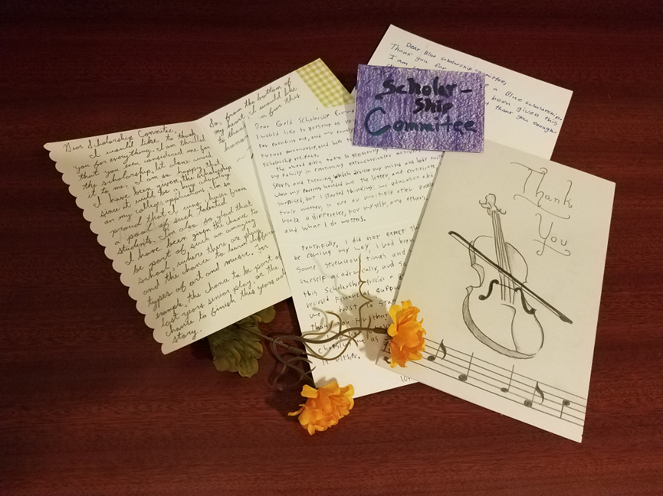
Scholarships
The school is able to offer two need-based scholarships: The Joan Condon Scholarship and the Diversity & Inclusivity Scholarship.
Both scholarship applications are available on our website.
Families can submit the scholarship applications online through a Google form.
Other High School Merit Scholarship opportunities..
Blue Scholarship
Alyssa Heberton Morimoto Scholarship

Slide 13
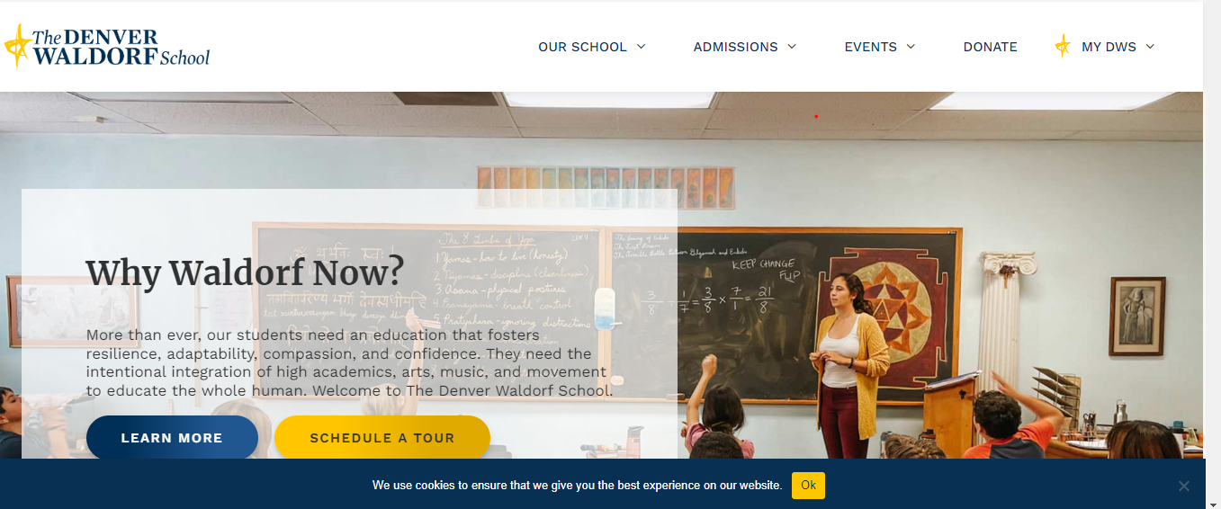
Scholarships on the DWS Website – Under the Admissions Tab

Slide 14
DWS Financial Overview

Slide 15
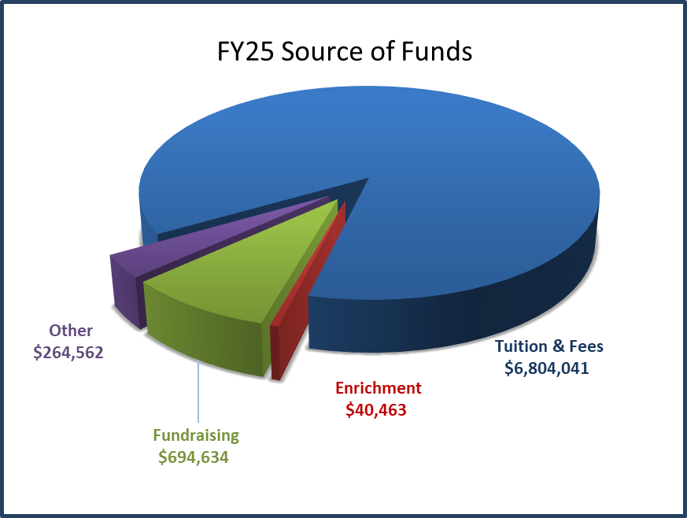
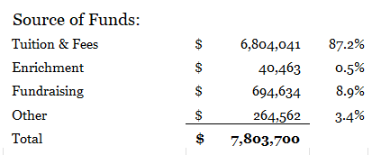
Source of Funds- Budget 2024-2025

Slide 16
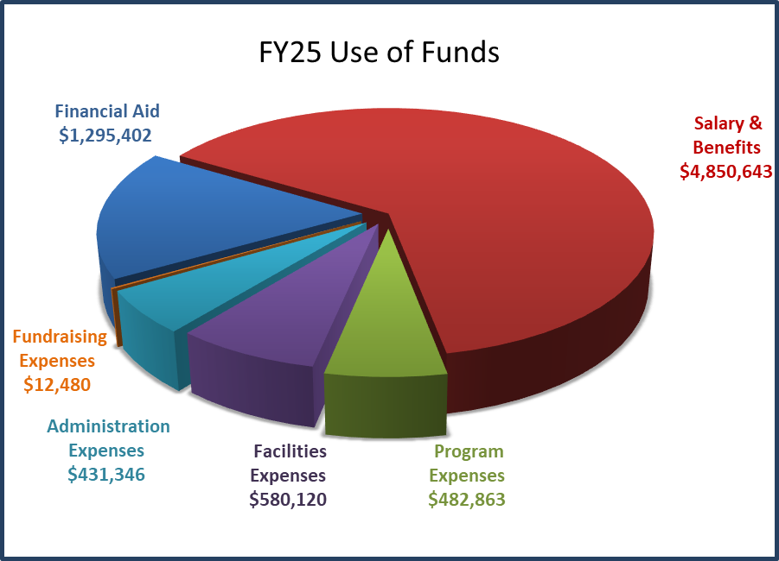
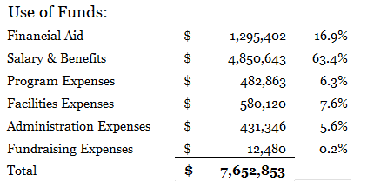
Use of Funds - Budget 2024-2025

Slide 17
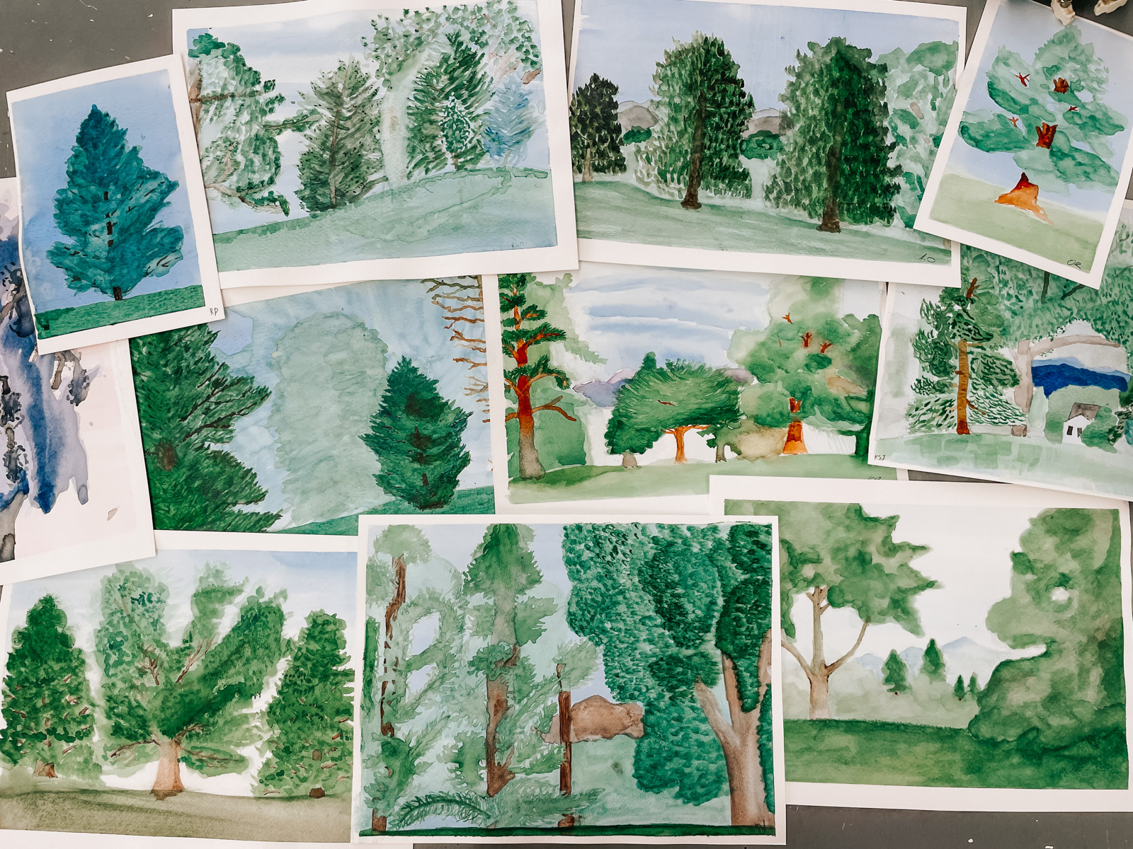
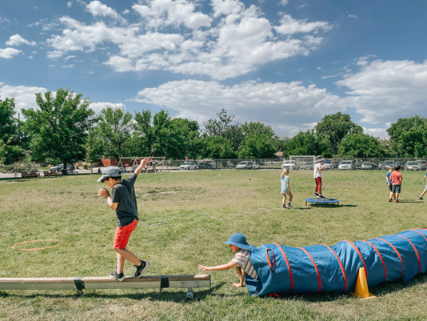
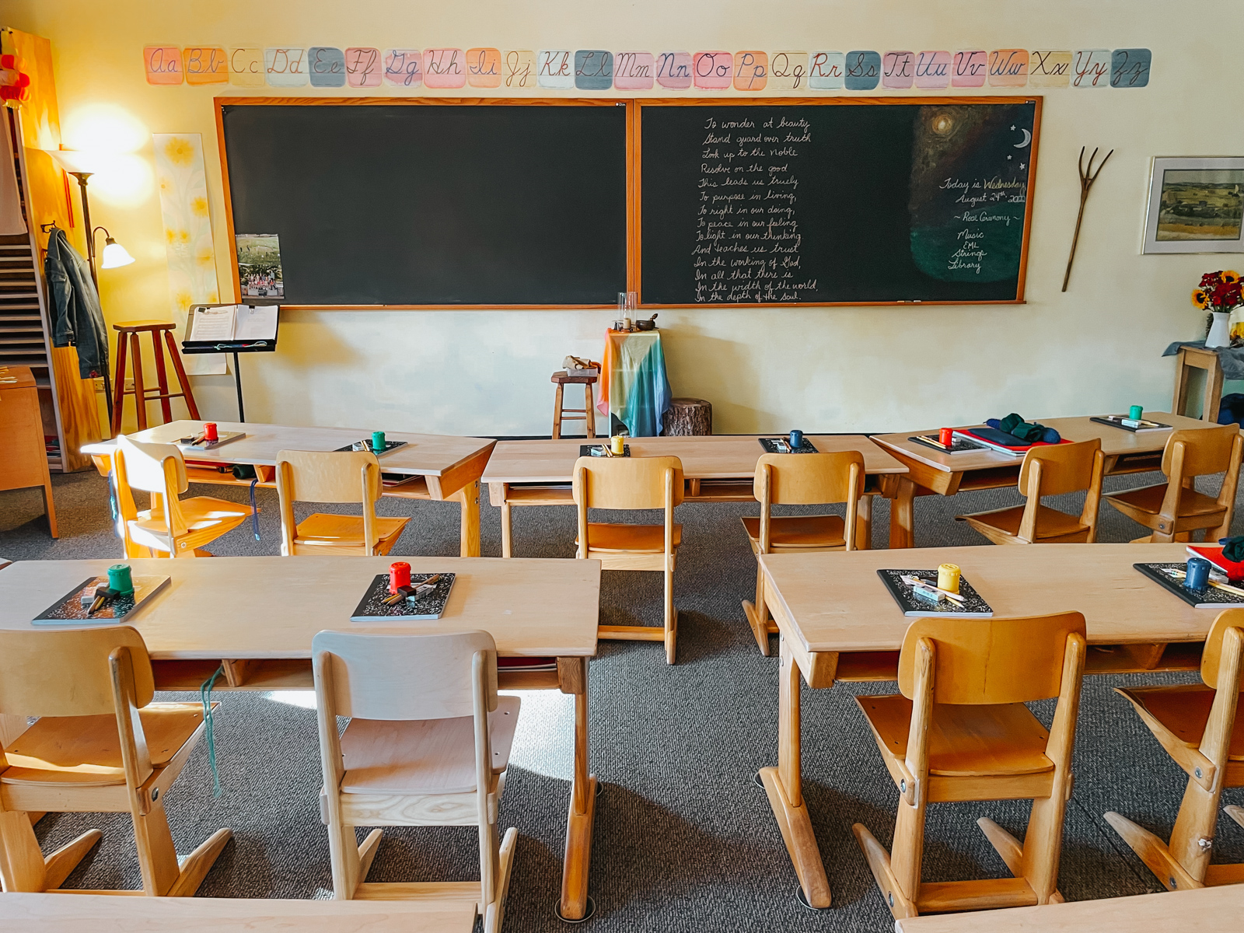
Questions?

Slide 18
Contact Information
Please contact Karlena Alonso Lamm, Director of Admissions, Marketing and Communications with questions about admissions at admissions@denverwaldorf.org
Please contact Karee Justice-Bondy, Director of Enrollment Records with questions about contracts and enrollment, as well as Tuition Adjustment and Scholarships kareejustice-bondy@denverwaldorf.org
Please contact Laurie Thompson, Finance Director with other questions about at business@denverwaldorf.org

